Slide 1
remotely accessing tfts computers
An introduction to accessing the Department’s computers and software
for staff and students

Slide 2
The Basics
By remotely accessing the department’s high-end workstation computers you can take advantage of their processing power and software licenses via any internet equipped computer.
You can connect from any of the public service machines in the Hugh Owen library and Rosser Lounge.
You can also configure your own personal computer for this purpose.
You will need;
A Mac/Windows/Linux computer and Broadband internet connection capable of playing HD Youtube streams.
VPN
Remote Access software

Slide 3
VPN
To access the network from off-campus you need to set up the University’s VPN on your computer.
For instructions on installing and configuring the University’s VPN client go to: https://www.aber.ac.uk/en/is/it-services/vpn/
The process requires the creation of a multi-factor authentication token. It is advised that you set up the MFA app on a smartphone or other portable device. With your device on campus and connected to the university network you can then create the authentication token yourself by following the online instructions. Otherwise you will need to ask the Information Services helpdesk for assistance. They can be contacted at: is@aber.ac.uk

Slide 4
HP ZCentral Remote Boost
This is the remote access software itself.
It comprises of two components; HP ZCentral Remote Boost HP ZCentral Connect Client
To download the installers go to the ‘Useful Links’ section of the Connect2 front page: https://tftsbookings.aber.ac.uk/default.aspx
Full instructions for installing and configuring ZCentral Remote Boost can be found at the following link: https://www.aber.ac.uk/en/media/departmental/tfts/tftsdocen/HP-Zcentral-Remote-Boost-setup-guide.pdf

Slide 5
HP ZCentral Remote Boost
Once you’ve got the VPN and Remote Boost set up you’re ready to connect to the department’s computers.
VPN
✔️
✔️

Slide 6
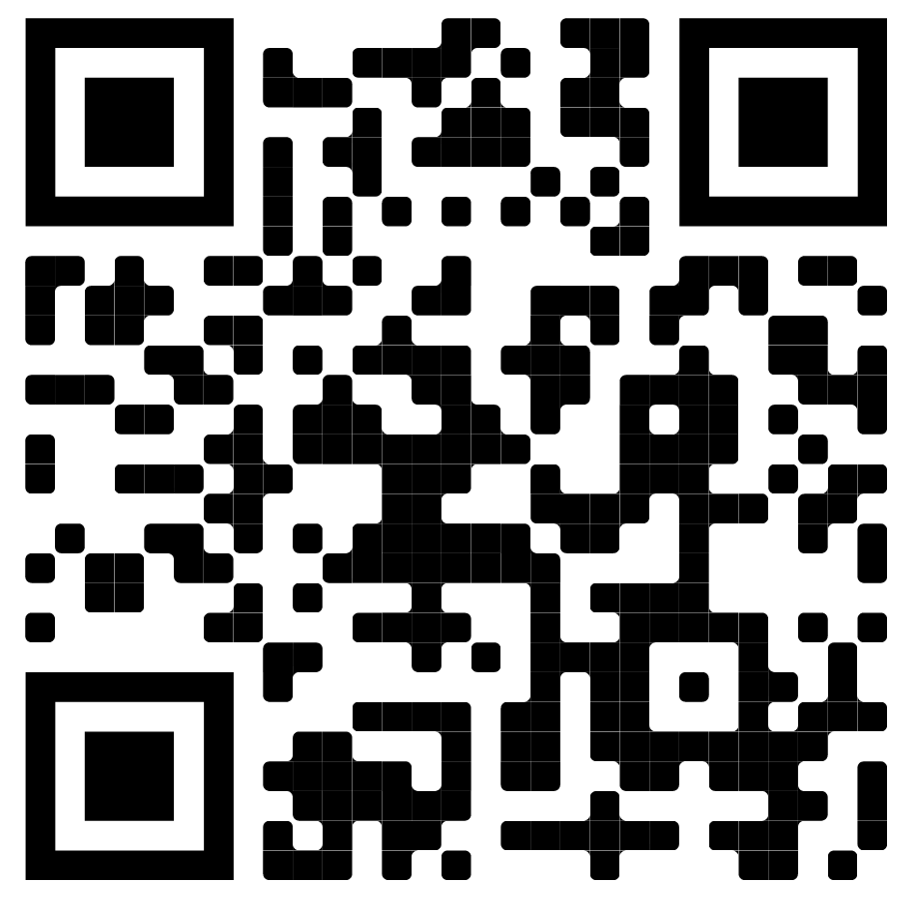
The Web Portal
Connect to the University VPN using GlobalProtect, then open a browser and navigate to: https://zcentral-connect.aber.ac.uk/
Log in with your Aber ID
You will be presented with a list of the ‘Pools’ of machines that you have access to. Choose the appropriate pool according to your timetable or booking.

Slide 7
Video Walk-through

Slide 8
Video Walk-through

Slide 9
Some Final Points
You will get much better performance if you eliminate all other network traffic at your end. Particularly detrimental to performance are video streaming services and online gaming.
If possible you should connect to your router with an ethernet cable rather than wirelessly.
The remote access system does not at present have the ability to restrict user access to scheduled times so it relies on the individual users showing the same consideration to each other as they would in person. Please don’t attempt to connect outside of a timetabled or booked session and please be sure to save your work, sign out, and release the host promptly at the end of your allotted time.

Slide 10
For Further Info
University VPN https://www.aber.ac.uk/en/is/it-services/vpn/
ZCentral Remote Boost setup guide https://www.aber.ac.uk/en/media/departmental/tfts/tftsdocen/HP-Zcentral-Remote-Boost-setup-guide.pdf
Avid Setup and Basic Operation https://www.dropbox.com/s/8eo609ig42zo3as/AVID%20SETUP%20AND%20BASIC%20OPERATIONv3.pdf?dl=0
Or contact me;
jsl11@aber.ac.uk

