Slide 1
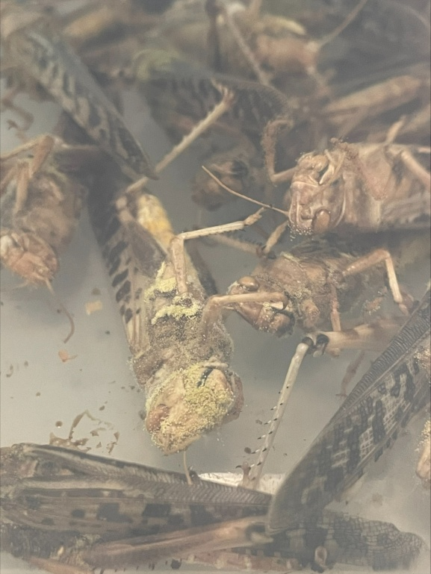
Biological control of crop pathogens using predatory bacteria
dew@aber.ac.uk
Pathogenic organisms are a threat to food security and sustainability as they reduce crop yields and increase food spoilage. Due to the emergence of antimicrobial resistance (AMR), alternatives to chemical pesticides are increasingly sought to target and control those pathogens. Bacterial predators such as myxobacteria can be thought of as living antibiotics, as they are able to kill pathogens, potentially preventing disease of farmed food (whether animal, plant or insect).
This experimental project will investigate whether various myxobacterial predators can be used as a biological control to protect crops (e.g. tomatoes, crickets, …) from pathogenic microbes. Diverse experimental approaches are available and depend on your interests. We might optimise methods for applying myxobacteria, isolate novel predators, characterise the activity of their toxic secretions, and/or use genetic engineering to identify the genes responsible for their predatory activity.
Fungal entomopathogens emerging from locust cadavers

Slide 2
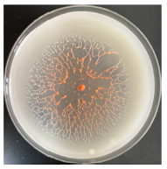
Isolation and characterisation of novel predatory bacteria
dew@aber.ac.uk
With the problems of antimicrobial resistance (AMR), alternatives to antimicrobials are in great demand. Potential alternatives to antimicrobials include the use of predatory bacteria, which are being investigated as ‘living antibiotics’. This experimental project aims to isolate novel predatory organisms from the environment. Once isolated, bacterial strains could be characterised using a variety of methods, including microscopy, physiological assays, phylogenetic methods, predation assays, etc. Particularly novel strains could be further characterised for description as new species, for example via genome sequencing and deposition in culture collections.
If you wanted, we might also start to investigate the antimicrobial activity of the new predators, trying to identify new enzymes, toxins and/or natural products.
The predatory bacterium
Herpetosiphon llansteffanensis

Slide 3
Bacterial genome evolution
dew@aber.ac.uk
The ability of bacteria to evolve resistance and spread resistance genes between populations has led to the current crisis of AMR (antimicrobial resistance). This project investigates the processes associated with genome evolution in predatory myxobacteria and could be either experimental and/or computational, depending on your interests.
Experimentally, we might measure the rates of horizontal gene transfer and DNA uptake, monitor the amelioration of newly acquired DNA as it adapts to a myxobacterial host, promote genome streamlining under selection for fast growth, or develop methods for genome editing.
Computationally, we might assess the presence and transfer of AMR genes in myxobacterial strains, investigate the evolution of gene clusters producing novel natural products, or investigate the spatial organisation of the core vs accessory pan-genome.
Electron micrographs of predatory Corallococcus spp.

Slide 4
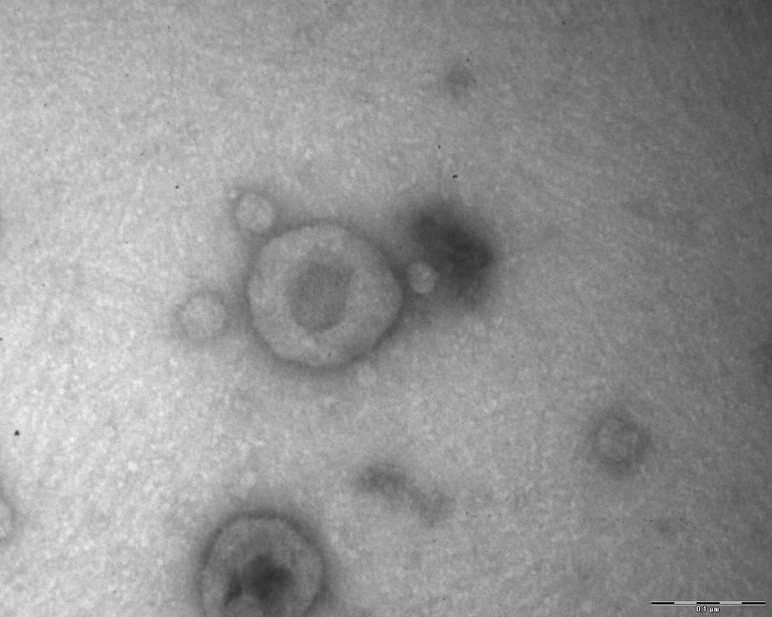
Understanding helminth extracellular vesicles
rom@aber.ac.uk
Parasitic helminth extracellular vesicles (EVs) are enriched with pathogen molecules, which could potentially be utilised for improved control of helminths. Helminth EVs are now known to function in numerous ways such as promoting or inhibiting host immunity, transporting molecules to recipient cells and even to detoxifying anthelmintic drugs. Therefore, understanding EVs from helminth parasites will aid our understanding of host parasite interactions whilst potentially leading to novel control options such as vaccinations or improved diagnostics. Projects in this area will develop skills in classical parasitology, EV purification and analysis, and a variety of omic technologies such as proteomics and peptidomics.

Slide 5
Invasive Chinese mitten crabs as food and behavioural enrichment for zoo animals
jei@aber.ac.uk
The Chinese mitten crab Eriocheir sinensis is one of the most damaging invasive non-native species in Europe. In the River Dee, North Wales, efforts are being made to trap mitten crabs as they migrate downstream to breed. This raises the problem of how to dispose of the captured crabs in a sustainable way. As invasive non-native species, they cannot be sold commercially.
This project would investigate whether mitten crabs trapped in the River Dee are suitable to feed to zoo animals, in terms of contamination and food quality. It might also be possible to investigate whether whole, dead mitten crabs provide behavioural enrichment to zoo animals who would normally eat crabs (e.g. Asian short-clawed otters). Students would gain experience in laboratory analysis of food quality and behavioural enrichment studies of zoo animals.

Slide 6
Origins of invasive non-native species
jei@aber.ac.uk
Discovering the origins of new introductions of invasive species in Wales is a research priority, as it can inform efforts to control the spread of non-native species through biosecurity measures. This project will use population genetic methods to investigate the origins of recently established priority invasive non-native species in Wales. These may include (for example):
American slipper limpet in Cardigan Bay
Chinese mitten crab in the River Conwy
Carpet sea squirt in Milford Haven
Students will gain experience in molecular laboratory work and may also have opportunities for marine and/or freshwater fieldwork.

Slide 7
Toxicity of mercury to the fungal symbionts of leaf-cutting ants
jei@aber.ac.uk
The use of mercury in artisanal gold mining is a major source of pollution in tropical rainforests. Leaf-cutting ants are among the most abundant and ecologically important organisms in neotropical rainforest ecosystems. They depend entirely upon symbiotic fungi which they farm in underground nests and feed with leaves cut in the surrounding rainforest. This project will aim to establish whether the fungi cultivated by leaf-cutting ants are harmed by exposure to the levels of mercury encountered in rainforests adjacent to artisanal gold mines. Students will gain experience in laboratory culture of fungi and ecotoxicological methods

Slide 8
Potential drugs from Seaweeds
ifp@aber.ac.uk
As many as 40 to 50 % of drugs currently used to treat human maladies are derived from terrestrial organisms. However, there is a requirement to encompass even greater biological biodiversity to tap into novel biochemical variation which will include many new compounds with pharmaceutical potential. The sea represents an almost untapped resource as it contains over 80 % of all life forms on Earth.
Preliminary research on Bladder Wrack (Fucus vesiculosus) has identified a range of (poly)phenolics. These often have antioxidant and UV-absorbing properties which are recognised by the pharmaceutical, nutraceutical and cosmetic industries. The novelty of seaweed species opens up the possibility of new IP, process developments and product differentiation. In this project, we propose to begin to assess the pharmaceutical potential of four locally sourced seaweed species; Bladder Wrack (Fucus vesiculosus); Knotted wrack (Ascophyllum nodosum), Toothed Wrack (Fucus serratus) and Gutweed (Enteromorpha intestinalis). The student will extract natural products from seaweed and extensively characterise these by HPLC, MS and NMR. The extracts will be assessed for anti-helminthic and anti-inflammatory activities. Extracts will be fractionated and defined anti-helminthic and anti-inflammatory activity related to discrete biochemicals.

Slide 9
Innovation and cognition of invasive and native crustacea
Sarah Dalesman & Joe Ironside
Innovation and cognitive ability are thought to be key traits associated with successful invasion potential of species, the ability to adapt behaviour to access new resources and new environmental challenges. However, work to date has focused on vertebrates, including birds and mammals. The proposed project will compare these traits in native and invasive crustaceans. The student will gain experience in experimental design, laboratory work, data analysis and presentation in comparative cognition.

Slide 10
Could snails be sentient?
Sarah Dalesman
There is a growing interest in the potential for sentience in invertebrates, which may impact on how we treat these animals from a welfare perspective. Cephalopods are currently protected in research under home office regulation, and decapod crustaceans have recently been recognised as sentient by the U.K. government. Gastropods are a very large phylogenetic group, used in both farming and research; however, we lack the evidence needed to determine whether this group could be considered sentient. The student will have the opportunity to explore areas of interest within this general area, for example if we can demonstrate support for ‘pain’ in gastropods, or whether they are capable of more complex cognitive processes generally assumed to be indicators of sentience.

Slide 11
Towards a companion diagnostic for breast cancer screening.
lum@aber.ac.uk
The current UK breast cancer screening has been very successful. In 2022-23 it screened 64.6 % of 1.93 million women for breast cancer by mammography and (in England) detected 18,942 cancer cases. Despite the considerable successes of the current breast screening modalities (e.g. mammogram, magnetic resonance imaging and ultrasound) in detecting the breast cancer, they also have their own limitations.
As part “Omics Approaches to Improve the Diagnosis, Management and Treatment of Breast Cancer” clinical study which has been ethically approved for 10 years (BECA, IRAS ID: 306872, Rec ref no.:21/SC/0411), (https://www.clinicalhubaberystwyth.com/beca) has been working with consultant mammographers who have highlighted how the current imaging tools can provide overlapping features observed in both benign (non-cancerous) and malignant (cancerous) disease that could result the false positive or false negative diagnosis.
BECA has identified of novel biological indicators (also known as biomarkers) in urine that could provide an early and accurate diagnosis of breast cancer. These could be used in a companion diagnostic test to improve the detection of malignant growths in breast cancer.
The BECA biomarkers could also be used be screen for breast cancer in low-risk women. The risks of breast cancer rise in post-menopausal women so that screening starts when women reach 50 years of age. However, there is a sizeable population of younger women (~18% of all cases in 2016-18) who develop breast cancer. There is a requirement to encourage younger, lower risk women to be tested. Our BECA biomarkers could be developed into a cost-effective test that could be used to screen younger women.
There are opportunities for master projects to help develop our understanding of changes in women at the earliest stages of breast cancer development and also changes seen with different types of breast cancer.

Slide 12
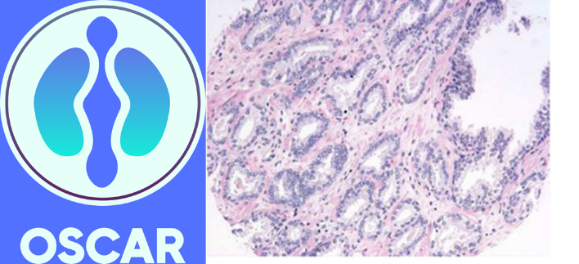
Developing a breakthrough technology for Prostate Cancer Screening
lum@aber.ac.uk
Globally, prostate cancer (PCa) affects over 1.4 million men, and causes over 375,000 deaths every year. The problem is set to get worse as the number of people with PCa is set to double by 2040 [1]. Presently, identifying patients with PCa depends on men coming forward to ask their doctor for testing. Testing usually involves determining the levels of prostate specific antigen (PSA) in blood, followed by a MRI scan and then prostate biopsies. One problem is that PSA-test gives a high number of false positives which can lead to unnecessary investigations, biopsies and treatment [2]
Aberystwyth University has established the OSCAR clinical study which is focused on defining key changes (“biomarkers”) in the urine of men linked to PCa. Currently, 12 hospitals are recruiting to the OSCAR study thar are located across Wales and England. OSCAR has ethical approval to recruit 10000 men on to the study. This makes OSCAR the largest study in the UK that is focusing on screening urine for PCa biomarkers.
OSCAR has already found biomarkers that have far superior accuracies that the PSA test. The OSCAR biomarkers are better at detecting higher grade (more aggressive) PCa compared to healthy men. The biomarkers also better at distinguishing between benign prostate growth (benign prostatic hyperplasia [BPH]) from PCa.
There are opportunities for master’s students to join scientists on the OSCAR study to test how the biomarkers change when the cancer is treated and what this can tell us about the underlying mechanism of tumours that respond well or badly to a particular treatment.
[1] James N, Tannock I, N’Dow J, Feng F et al Published Online April 4, 2024 https://doi.org/10.1016/S0140-6736(24)00651-2
[2] https://www.pulsetoday.co.uk/news/clinical-areas/cancer/six-different-proposals-for-prostate-cancer-screening-under-consideration/#:~:text=He%20said%3A%20'All%20PSA%2D,study%20from%20University%20College%20London.

Slide 13
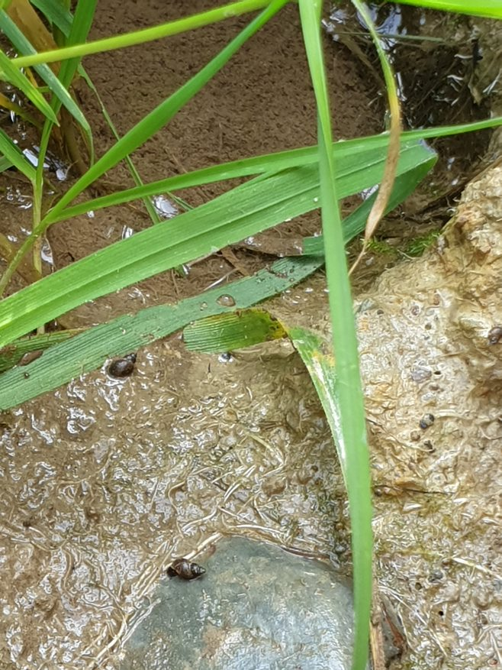
Environmental DNA survey of freshwater snails on farmland to assess the risk of liver fluke transmission in areas where G. truncatula is absent.
raj22@aber.ac.uk
Galba truncatula is the main intermediate snail host of liver fluke (F. hepatica) and it is assumed that if it is absent from an area then liver fluke cannot transmit. Our current research shows that this snail is absent from areas commonly assumed to be fluke transmission sites by farmers which indicates that fluke transmission risk may be lower than anticipated on certain farms. However, other snails, including O. glabra and R. balthica can also transmit fluke, although their presence on farmland is somewhat uncertain. Using an eDNA metagenomic analysis approach, we will aim to identify which other amphibious snails are present on Welsh farmland with focus on those that may transmit fluke.

Slide 14
Balancing veterinary disease control with biodiversity: Surveying amphibian presence in liver fluke infection sites via environmental DNA metagenomic analysis.
raj22@aber.ac.uk
As chemical control of liver fluke (F. hepatica) becomes increasingly difficult due to drug resistance and climate change, there is growing interest in using land management strategies to limit fluke infection opportunities. However, these strategies which may include draining, fencing, tree planting or avoidance of grazing may impact other wildlife species that also inhabit these sites. However, fluke infection risk areas are poorly defined and there is limited knowledge of their value to wildlife species and overall biodiversity. Using an eDNA metagenomic approach this project will identify which amphibian (or other groups) species are commonly present in such sites which will inform of how these areas should be managed in future.

