Slide 1
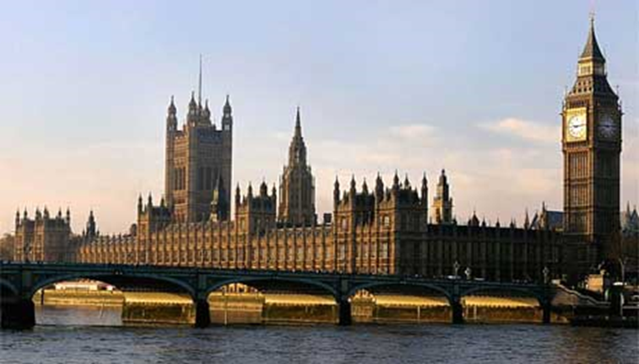
House of Commons Senedd Cymru Haf/Summer of 2025 Cyfarfod Gwybodaeth/Information Meeting 06 Tachwedd/November 2024
Dr R. Gerald Hughes
Tiwtor Chyflogadwyedd/Employability Tutor
rbh@aber.ac.uk

Slide 2
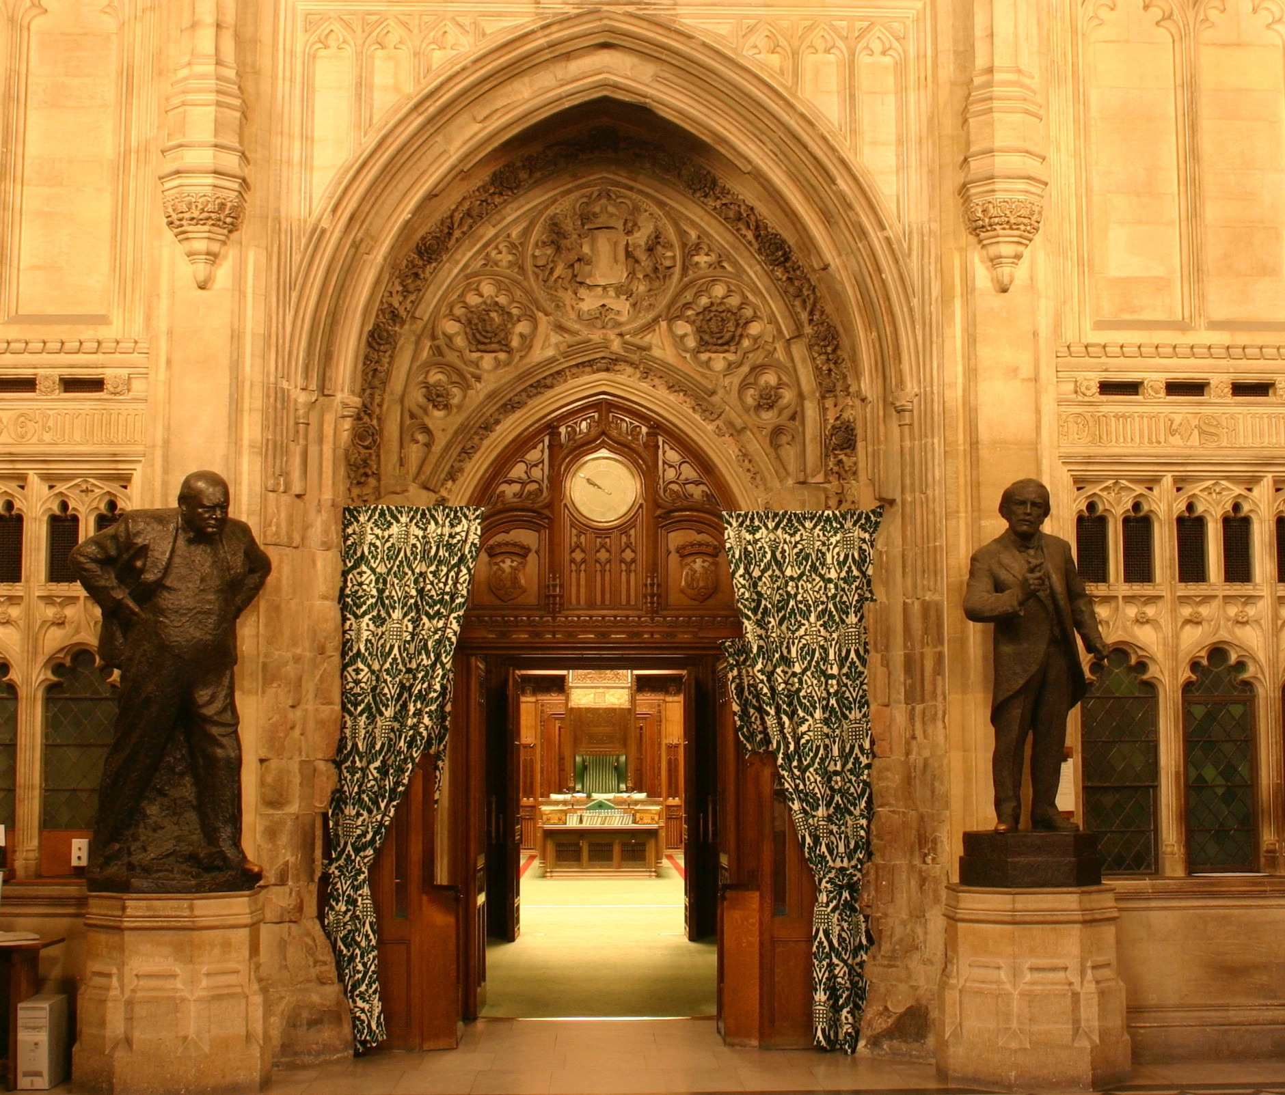
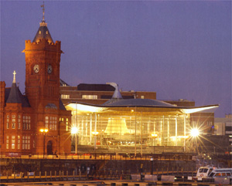
Cynllun Lleoliadau Seneddol Parliamentary Placement Scheme
What is it?
Summer placement at Senedd Cymru, Cardiff or the House of Commons, London
Placement with an MS/MP or political party
Successful applicants are given a variety of tasks
Placement usually lasts from four to six weeks

Slide 3
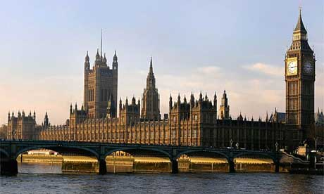
Parliamentary Placement Scheme: requirements for applicants
What are we looking for?
Second year students – single honours, joint or major/ minor
Competitive application process
Not necessarily just academic high flyers (although marks are very important)
Good ambassadors for the university

Slide 4
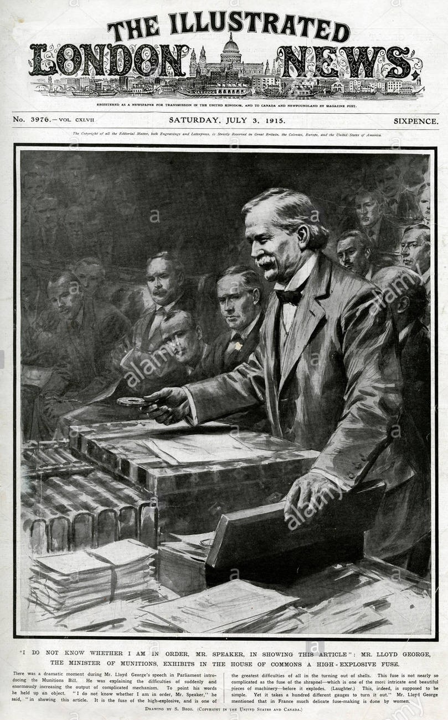
Places, finances and application
Funding: All successful students will be eligible for awards of between £250 and £500 towards costs
How do I apply?
Complete application form
Prepare a curriculum vitae
Speak to Tony Orme in Careers before submission (e-mail: awo@aber.ac.uk)
Covering letter (i.e. why you think you’re a good candidate)
Deadline will be in mid-February 2025

Slide 5
Timelines
The application form should be downloaded, completed and submitted with the rest of the application, together with a CV, a one-page explanation of why you want to go on the scheme (a cover letter) by e-mail to Dr R. Gerald Hughes (rbh@aber.ac.uk) and Ceuron Bryn Tecwyn (cet18@aber.ac.uk) in mid-February 2025
If selected to go forward for a placement, the CV and personal statement will be sent to potential host MPs/MSs. This application form is for Departmental purposes only
All applicants will be notified by e-mail in late February 2025 to let them know if they have been shortlisted
The provisional interview date for shortlisted candidates will be in early March 2025. Successful candidates who have been chosen for the scheme will be notified during mid-March 2024
After that, the process of matching students with MPs and MSs will begin
Placement confirmed
Finally, successful candidates will contact the offices of MSs/ MPs so as to finalise arrangements, security pass and the like
Notes:
*Application form is here: https://www.aber.ac.uk/en/media/departmental/interpol/pdf/undergraduate/HoC-Senedd-Placement-Schemes-APPLICATION-FORM--SUMMER-2021.pdf

Slide 6
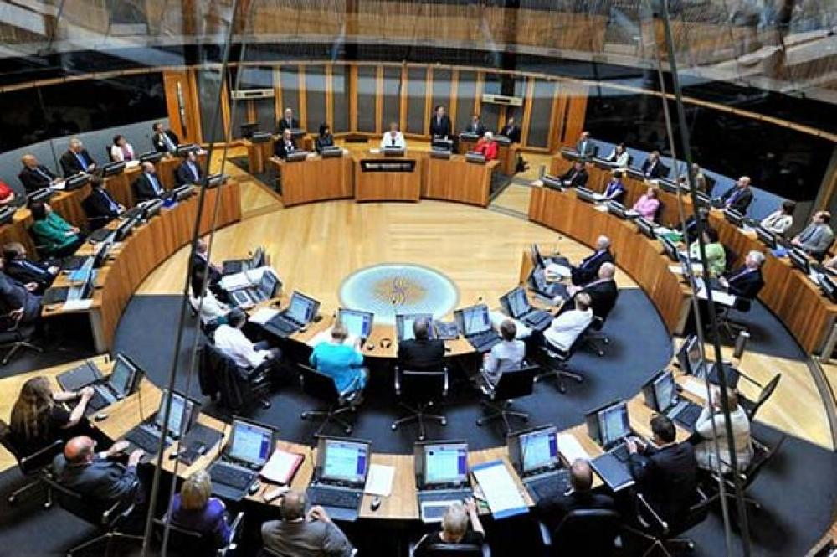
Provisional summary of deadlines and dates*
Mid-February | Submit application form to rbh@aber.ac.uk and Ceuron Bryn Tecwyn cet18@aber.ac.uk
Late February | Notification of short-listed candidates
Early March | Interviews
Mid-March | Notification of results to short-listed candidates
*Dates may be subject to alteration
Notes:
*

Slide 7
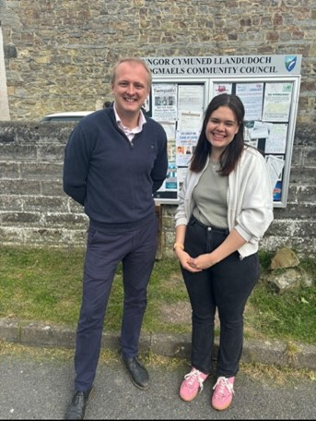
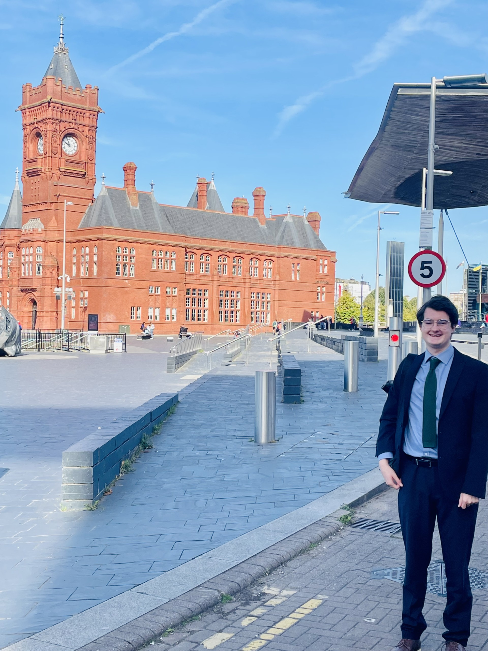
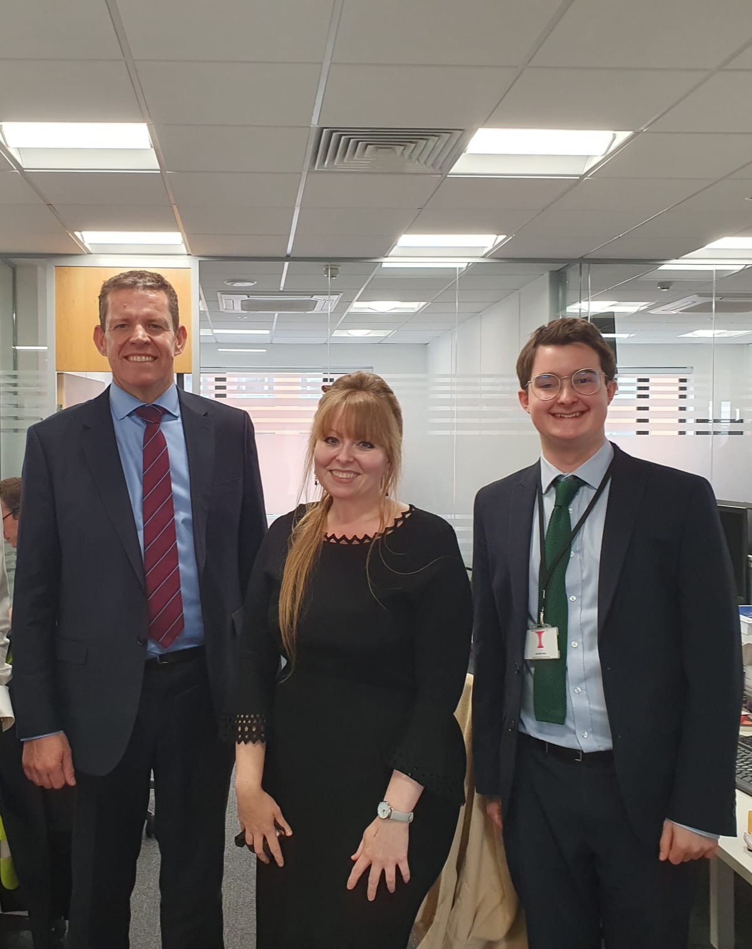
Some of our 2024 placements
Loti Glyn: Placement – Ben Lake MP, Ceredigion, House of Commons
Arthur Wacker: Placement – Delyth Jewell AS, South Wales East, Senedd Cymru
Matilda Falchetta: Placement – Huw Irranca-Davies, MS, Ogmore, Senedd Cymru

Slide 8
Senedd Cymru
Cross Party Groups (diabetes, educational reform)
Committee Meetings (Children, Young People and Education Committee)
Events (Basque Country and European Higher Education Forum Reception)
Drafting questions to the First Minister and other ministers (community allotments)
Research background on the topic and providing brief report to the MS
Make notes during meetings and events
E-mailing constituents, Charities, Businesses and Union representatives
Running social media
Taking the train to Newport to work in the constituency office
Photocopying, tea-making etc.

Slide 9
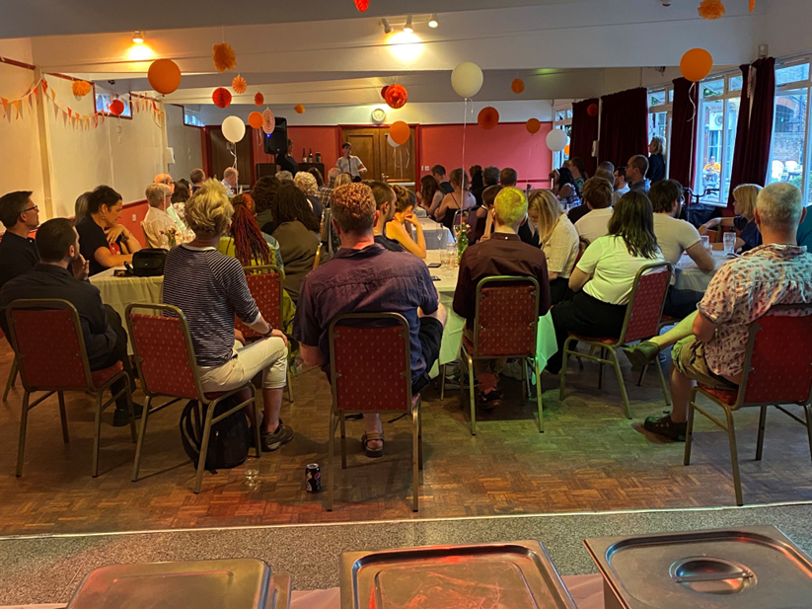
Westminster
Constituency Casework
Researching and referring constituent case
Drafting of official letters & emails
Writing briefings for, and attending, meetings
Assisting with the planning and running of events in the constituency
E.g. fundraisers for the MP
Community Comms
Attending events in Parliament
Photocopying, tea-making etc.

Slide 10
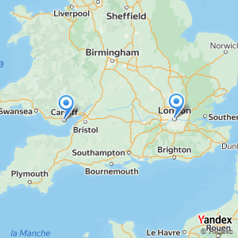
Practicalities and logistics
Potential expenses: accommodation, travel, food
Cardiff: most of my time was spent in university accommodation which was a 40-minute walk away
London: I was 15-minute walk away from the constituency office, and 40 minutes away from Westminster
London: accommodation is difficult to source, however, good transport links so looking just outside London is also possible
Use websites like spareroom.co.uk, or try to book university accommodation if you receive the offer of a placement
Dress Code
Senedd: I wore a suit and tie however not everyone was this formal. It can vary between offices, so seek advice where appropriate
Westminster: it is a formal business dress code (suit and tie)
Senedd and Westminster: in the constituency offices it varies depending on the tasks required that day – usually smart casual

